Slide 1
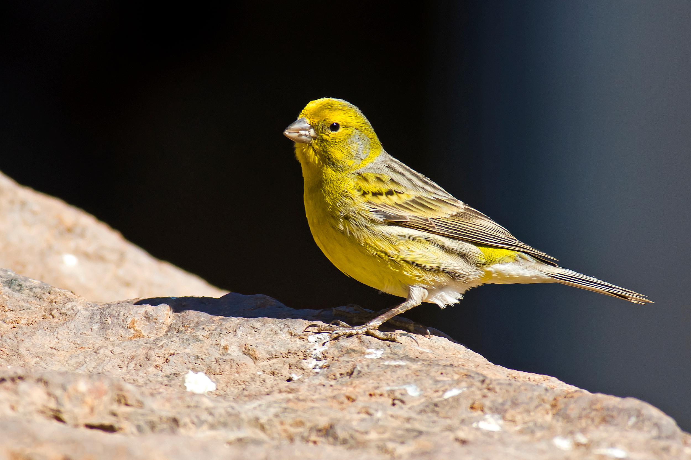
Photoperiodic induced changes in reproductive state of border canaries (Serinus canaria) are associated with marked variation in hypothalamic gonadotropin releasing hormone immunoreactivity and the volume of song control regions
Laura L. Hurley *, Andrea M. Wallace, Jennifer J. Sartor, Gregory F. Ball

Slide 2
Background
Canaries have seasonal variation in gonadal activity
Behaviors are associated with marked brain changes
GnRH expression and song nuclei volume (HVC, RA, Area X)
Discrepancies in data regarding neuroplasticity and seasonal breeding in different canary species
Possibly due to varying stimuli sensitivity
Absolute vs non-absolute photorefractoriness
Three different reproductive periods
Photosensitive
Photostimulated
Photorefractory

Slide 3
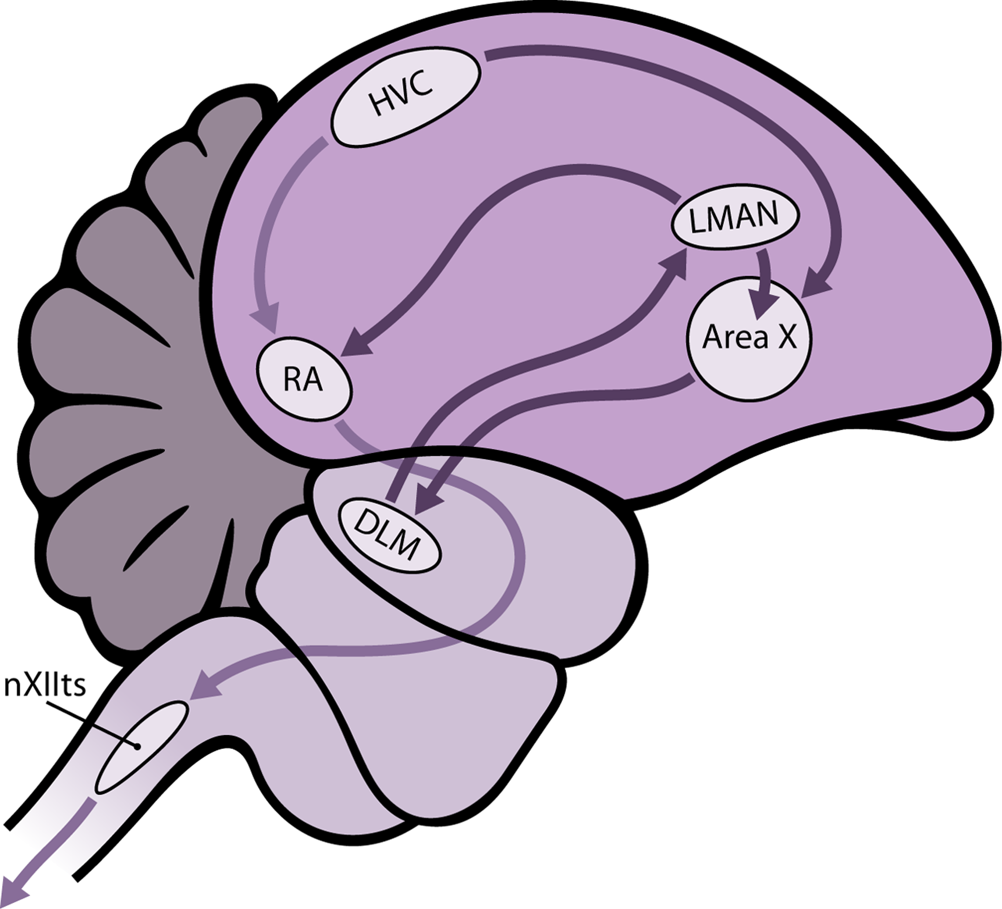
Song vocalization
HVC
Controls both learning and production of bird song
Area X
Homolog to basal ganglia
Vocal learning
RA
Controls motor neurons to help make song

Slide 4
Methods
Canaries housed for 6 weeks on short days (8L:16D) to ensure equal photosensitivity for 6 weeks
Experiment 1
Breeding condition determined via exploratory laparotomies
Measurements of testis and ova
Males: 4, 7, 11, 17 weeks
Testis diameter
Females: 4, 8, 12, 17 weeks
Follicle volumes
“In lay” determined via egg yolk
“Non lay” determine with formula for sphere
Blood samples collected from alar vein in wing for hormone analysis
Molt of both sexes scored to determine progression towards photorefractoriness

Slide 5
Methods cont
Experiment 2
Animals divided into the three treatment groups: photosensitive, photostimulated, photorefractory
⅓ kept on long days (photorefractory)
⅓ put on short days (photosensitive)
⅓ put on short days for 6 weeks and placed back on long days for 4 weeks (photostimulated)
Brain was extracted and frozen on dry ice until processed
Nissl stained
Volume of song nuclei
Processed for localization of GnRH with an immunocytochemical procedure
Counting number of cells in POA
Radioimmunoassay conducted on plasma fractions to determine testosterone level in male and female
ANOVAs used for statistical analysis

Slide 6
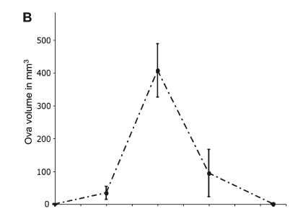
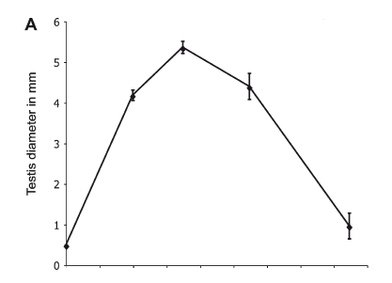
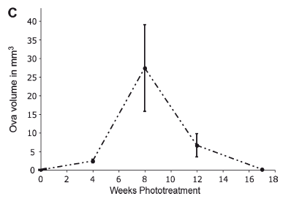
Figure 1

Slide 7
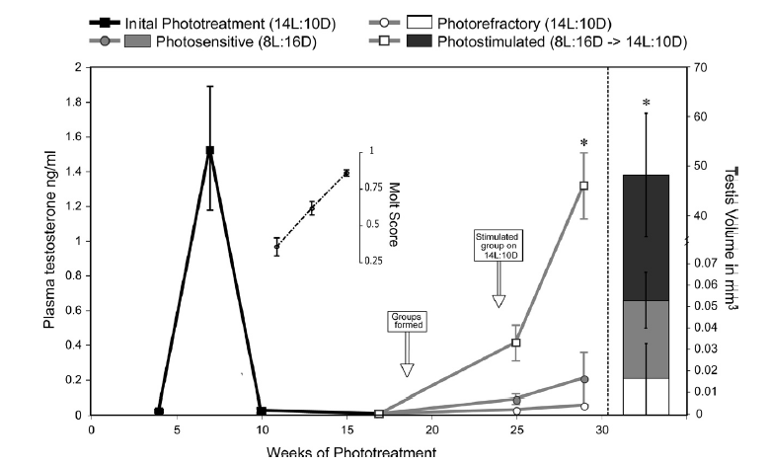
Figure 2

Slide 8
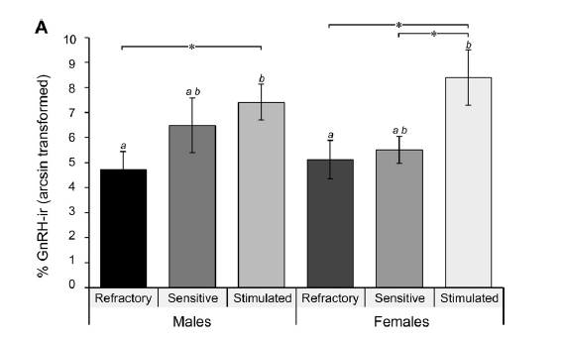
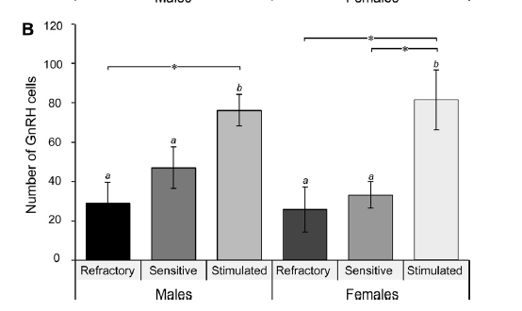
Figure 3

Slide 9
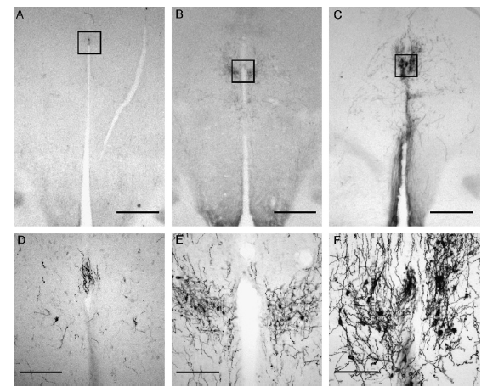
Figure 4

Slide 10
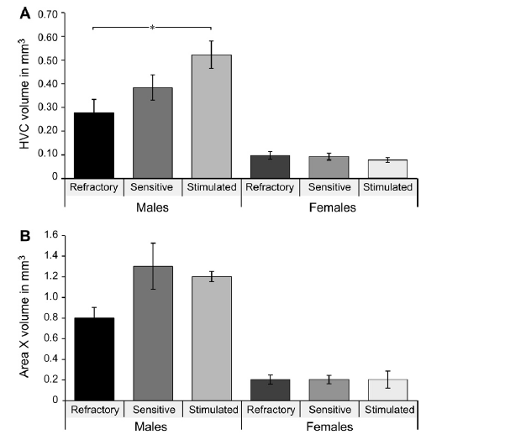
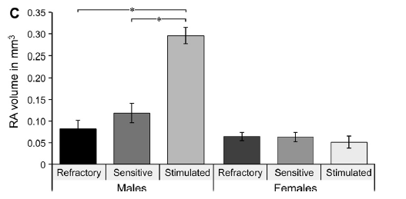
Figure 5

Slide 11
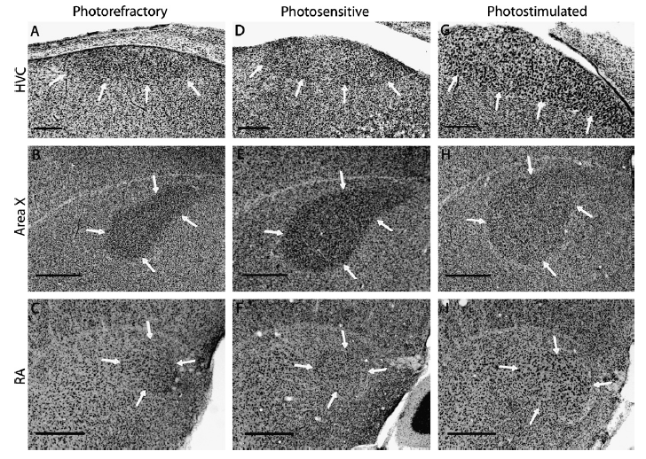
Figure 6

Slide 12
Discussion
Produced expected results in both male and female subjects, further confirming this canary species exhibits absolute photorefractoriness
Observed marked neuroplasticity in two neuroendocrine systems
Preoptic-hypothalamo GnRH that regulates the release of gonadotropin hormones released from the pituitary gland
Forebrain song control circuit that regulates seasonal changes in song behavior
Pho­to­sen­si­tive and phot­osti­mu­lat­ed canar­ies tended to exhibit higher amounts of GnRH immu­no­re­ac­tiv­ity than birds in a pho­to­re­frac­to­ry state
Over­all the pattern of breed­ing that was observed fits in well with other cardu­e­line finches that are clearly pho­to­pe­riodic, but exhibit flex­i­bil­ity in the tim­ing of breed­ing depend­ing on the avail­abil­ity of sup­ple­men­tary cues.
Rainfall, habitat changes, etc.

Slide 13
Discussion cont
Pho­to­pe­ri­odic manipu­la­tions that place birds in dif­fer­ent repro­duc­tive states are asso­ci­ated with dif­fer­ences in the vol­ume of song nuclei
After these experiments, changes that under­lie spe­cies var­i­a­tion in breed­ing flex­i­bil­ity and the asso­ci­ated neu­ro­plas­tic­i­ty should be studied

